Slide 1
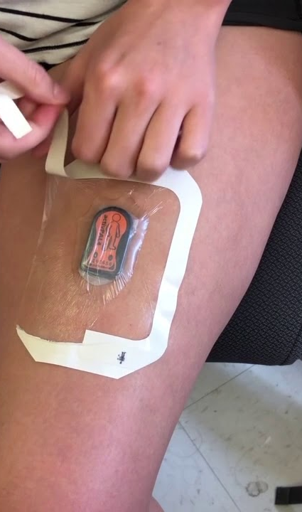
ActivPal External Presentation #3
Adnan Akbas Ali Safdari Mark Boon Matthew Turkenberg Colin Werkhoven

Slide 2

Topics
Our progress
Problems
Next steps
Questions

Slide 3
What have we been working on
Activity recognition
MET prediction models
Walking
Running
Cycling
Standing
Sitting
Synchronizing models
Improving dataset
Application that implements our models

Slide 4
Activity recognition
Model and dataset configurations
Scores
dataset type | Accuracy | Precision | Recall
Validation | 98.46% | 98.70% | 98.59%
Test | 98.46% | 98.63% | 98.46%
Random Forest Model
Segment time in 9.4S
Features of all axis
Standard deviation
mean
K-fold cross validation score
Accuracy | Precision | Recall
96% (+/- 3%) | 97% (+/- 2%) | 96% (+/- 3%)
Notes:
Short reminder the model used
We have used random forest model to classify data. First we have segmented data in 9.4S and summirazed by calculating standard deviation and mean of th X, Y and Z axist. We put activity label on it and trained the model with it.
The scores of the model are presented in table on the right side. The validation and test scorers gives quite high scores. This was suspicous to us. So we have implemented K-fold cross validation using Sklearn library.
As you can the scores went down a little bit but still high. So we can conclude that activity recognition model is finished and it's working quite well

Slide 5
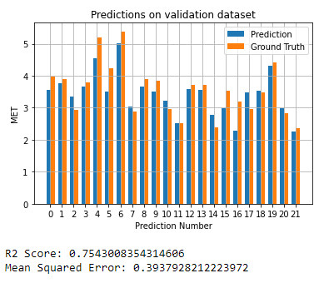
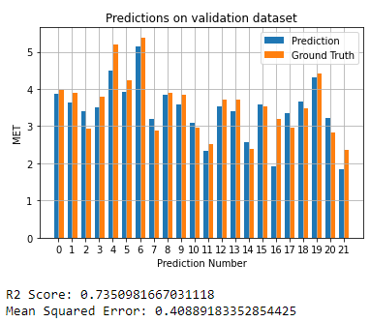
MET prediction - walking
Random Forest Results
XGBoost Results
6 features used:
- sum_mag_acc
- weight_kg
- length_cm
- age_category
- meets_balance_guidelines
- mean_speed
6 features used:
- sum_mag_acc
- weight_kg
- length_cm
- age_category
- meets_balance_guidelines
- mean_speed
Notes:
For the walking prediction we compare random forest with xgboost. In this case the features were the same for both models.
Looking at the results you can see there is very little difference between the models.
We decided to go for XGBoost even though the results are slightly worse since most of our models got the best results for XGBoost.

Slide 6
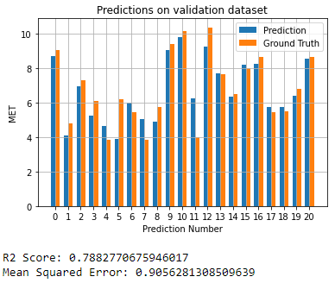
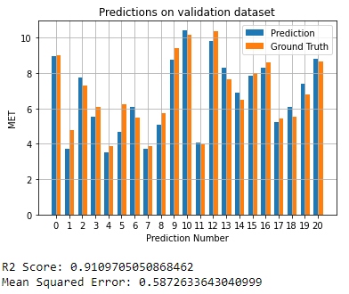
MET prediction - running
Random Forest Results
XGBoost Results
6 features used:
- sum_mag_acc
- weight_kg
- length_cm
- age_category
- estimated level
- mean_speed
6 features used:
- sum_mag_acc
- weight_kg
- length_cm
- age_category
- is_sporter
- mean_speed
Notes:
For the runnning prediction we compare random forest with xgboost. We applied recursive features selection (RFE) to get the best features.
In this case the features were different to get a final results for both models.
Looking at the results you can see that the XGBoost models performs a lot better compared to the Random Forest model.
We decided to go for XGBoost since this model got much better results.

Slide 7
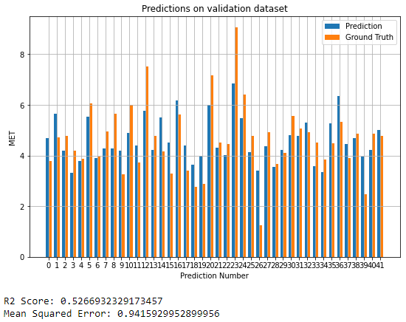
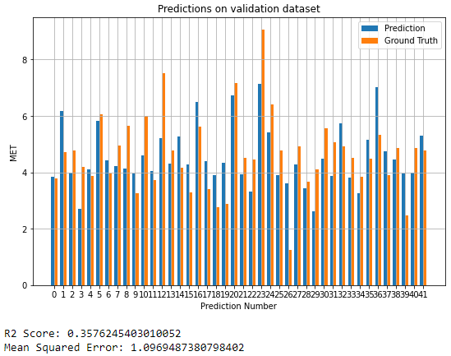
MET prediction – cycling (light + heavy)
Random Forest Results
XGBoost Results
6 features used:
- sum_mag_acc
- weight_kg
- length_cm
- age_category
- meets balance guidelines
- mean_speed
Notes:
The results for cycling were one of the hardest to predict since the activpal device is mounted on the thigh and barely changes while cycling light or heavy.
The 2 models use the same features.
Looking at the results you can see that the Random Forest gives better results, but we are still not really happy with the results of both models to we still have to do some work on both models.

Slide 8
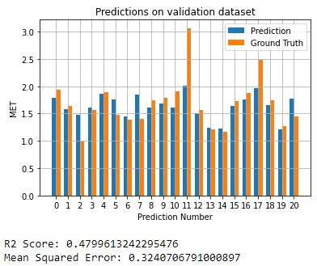
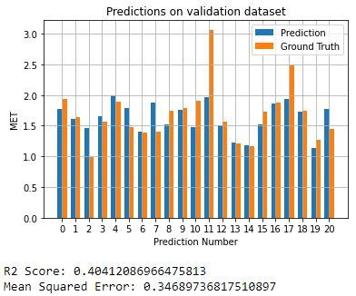
MET prediction - standing
Random Forest Results
XGBoost Results
7 features used:
- sum_mag_acc
- weight_kg
- length_cm
- age_category
- meets balance guidelines
- gender
- mean_speed
6 features used:
- sum_mag_acc
- weight_kg
- length_cm
- age_category
- meets activity guidelines
- mean_speed
Notes:
For the standing prediction we compare random forest with xgboost. We applied recursive features selection (RFE) to get the best features.
In this case the features were different to get a final results for both models.
Looking at the results you can see that the XGBoost models performs a bit worse compared to the Random Forest model.
We decided to go for XGBoost since there is very little difference and we use the XGBoost for most of our met prediction models.

Slide 9
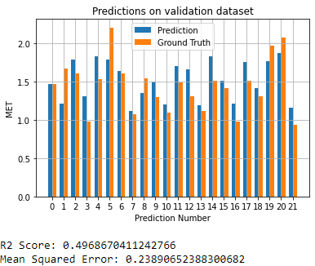
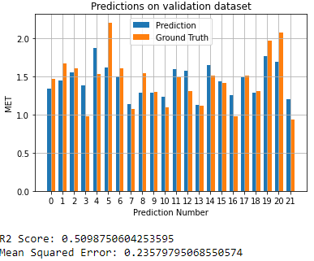
MET prediction - sitting
Random Forest Results
XGBoost Results
6 features used:
- sum_mag_acc
- weight_kg
- length_cm
- age_category
- is_sporter
- mean_speed
Notes:
For the sitting prediction we compare random forest with xgboost. We applied the same features and received almost the same results.
We decided to go for XGBoost since there is very little difference and we use the XGBoost for most of our met prediction models.

Slide 10
Application
Functionalities
Recognizing activities
Predicting MET-values
Plotting week data
Calculating if user has done it's 150 min moderate activity

Slide 11
Application – plot week data
Each color represents a activity

Slide 12
Application – recommended moderate activity
User has done its recommended amount 150 minutes of moderate activity
Moderate activity is all activity with MET-value equal to or higher than 3 until 6. The application also takes met value higher than 3 in to account in its calculation

Slide 13
Problems
Application is slow
Speed calculation bug in the application

Slide 14
Next steps
Try to fix the speed calculation bug in the application
Find similar papers for inspiration for our own paper
Write the general layout of the paper
Think of a good way to visualize our findings in the paper

Slide 15

Questions?

